Slide 1



Department of Information Technology
Final Year Project
Batch No: 4
Second Review
Spatio-Temporal Attention Mechanism on MRI Slice Sequences for Multiple Sclerosis Diagnosis
TEAM MEMBERS :
Guide name:
Mrs. J MANJU, M.E
Assistant Professor
Abinash A
Monish V
Charukesh M
Mohammed Raashidh S
- 113123UG07001
- 113123UG07072
- 113123UG07017
- 113123UG07069

Slide 2

EXISTING SYSTEM
1. 2D CNN-Based Methods
These methods take individual MRI slices as input, feeding them through a CNN for classification.
They excel in image-based analysis and are relatively lightweight.
However, they may overlook crucial information about feature changes across consecutive slices, since each slice is treated independently.
2. 3D CNN-Based Methods
These methods take the entire MRI volume (a stack of slices) as input and process it using a 3D CNN.
A 3D CNN processes the entire MRI volume, capturing spatial relationships in all three dimensions and providing a more complete view of the brain.
This approach requires significantly more memory and computational power, often becoming a bottleneck in resource-constrained settings.

Slide 3
FEASIABILITY STUDY
Technical Feasibility
The project relies on established deep learning techniques.
EfficientNet-B0 is chosen as the backbone, offering strong feature extraction with minimal weight.
A BiLSTM layer processes an ordered sequence of slice-level features, capturing temporal dependencies.
An attention mechanism can be added to learn which slices are most important for the final prediction.
Grad-CAM provides interpretable visual explanations of the model’s decisions.

Slide 4
FEASIABILITY STUDY
Dataset Feasibility
The project can use publicly available brain MRI datasets with MS-related cases.
The final dataset selection will depend on several practical factors:
  The number of subjects available
  Which MRI modalities are provided (e.g., T1, T2, FLAIR)
  The availability and consistency of slice data
  The presence of clear class labels (e.g., MS vs. non-MS)
  Overall data quality and annotation reliability

Slide 5
FEASIABILITY STUDY
Computational Feasibility
Using EfficientNet-B0 keeps feature-extraction computationally efficient compared to heavier CNN architectures.
The proposed design avoids full 3D CNNs, reducing memory and GPU requirements.
This makes the approach feasible on standard research-grade hardware.
Project Feasibility
The work can be carried out in clear, manageable stages:
  Dataset selection and exploration
  Preprocessing and sequence preparation
  Model architecture development
  Training and hyperparameter tuning
  Evaluation using subject-level cross-validation
  Explainability analysis with Grad-CAM

Slide 6
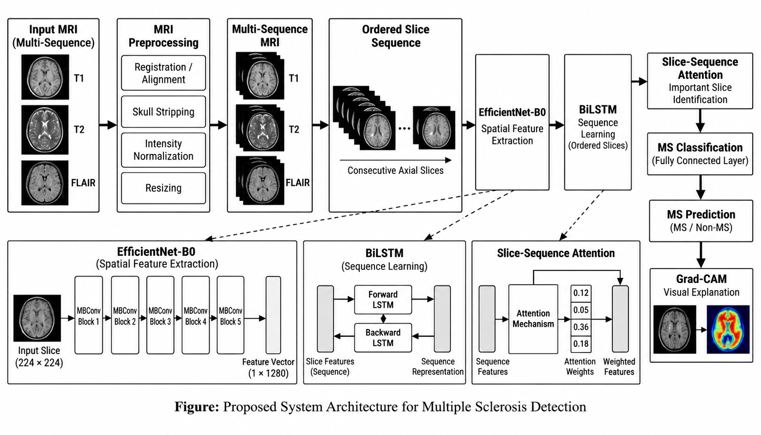
SYSTEM ARCHITECTURE

Slide 7
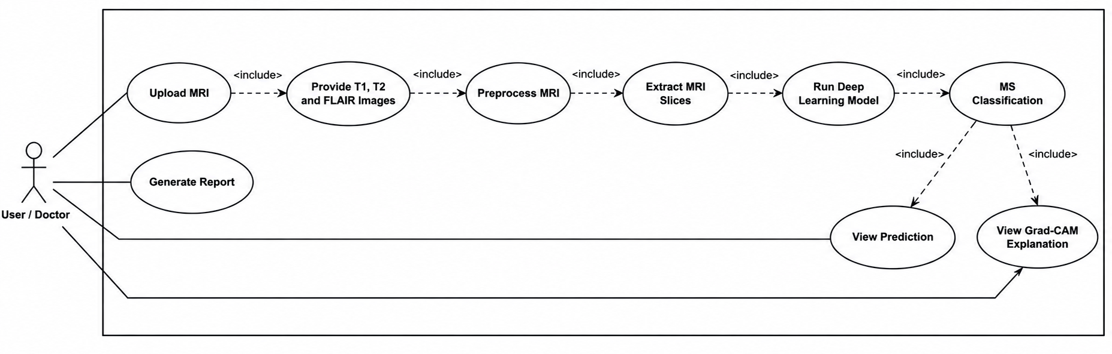
USE CASE DIAGRAM

Slide 8
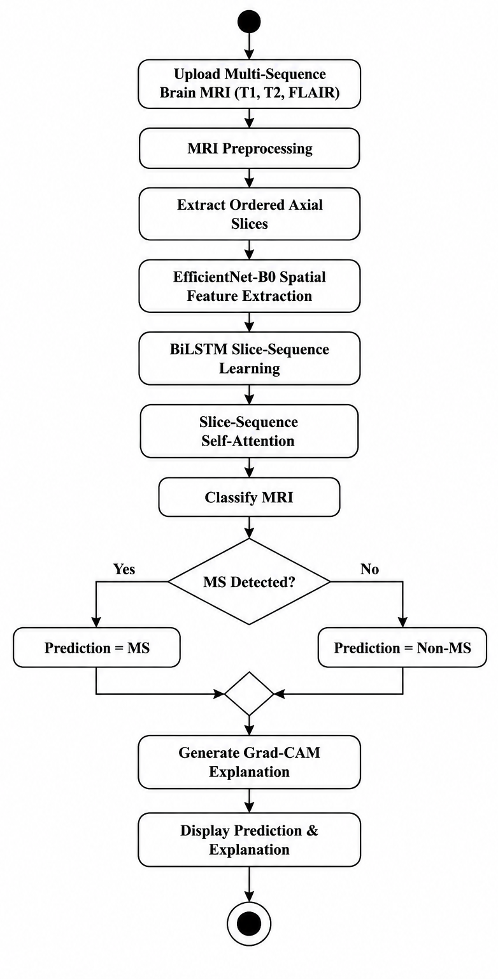
ACTIVITY DIAGRAM

Slide 9
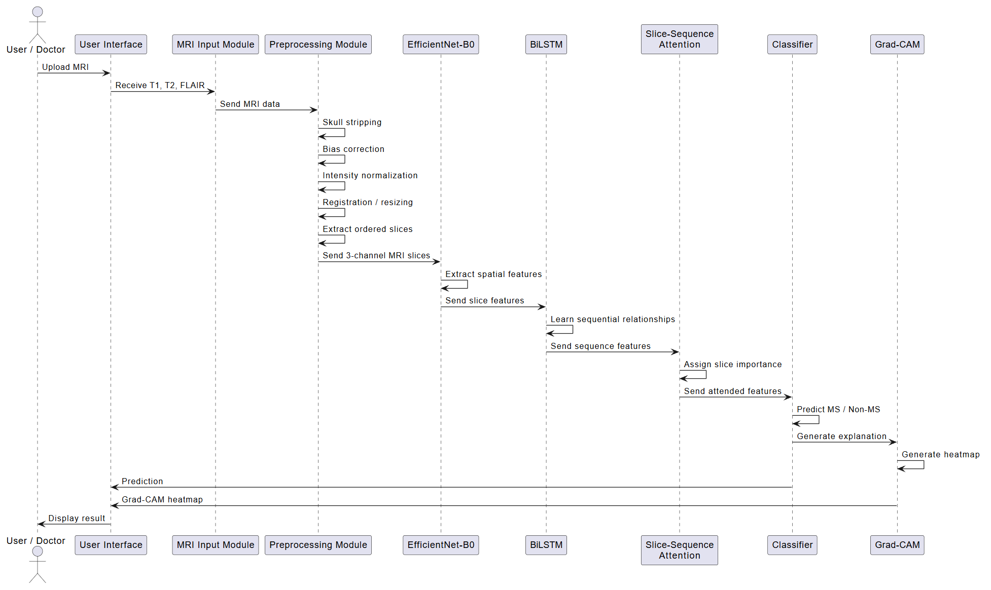
SEQUENCE DIAGRAM

Slide 10
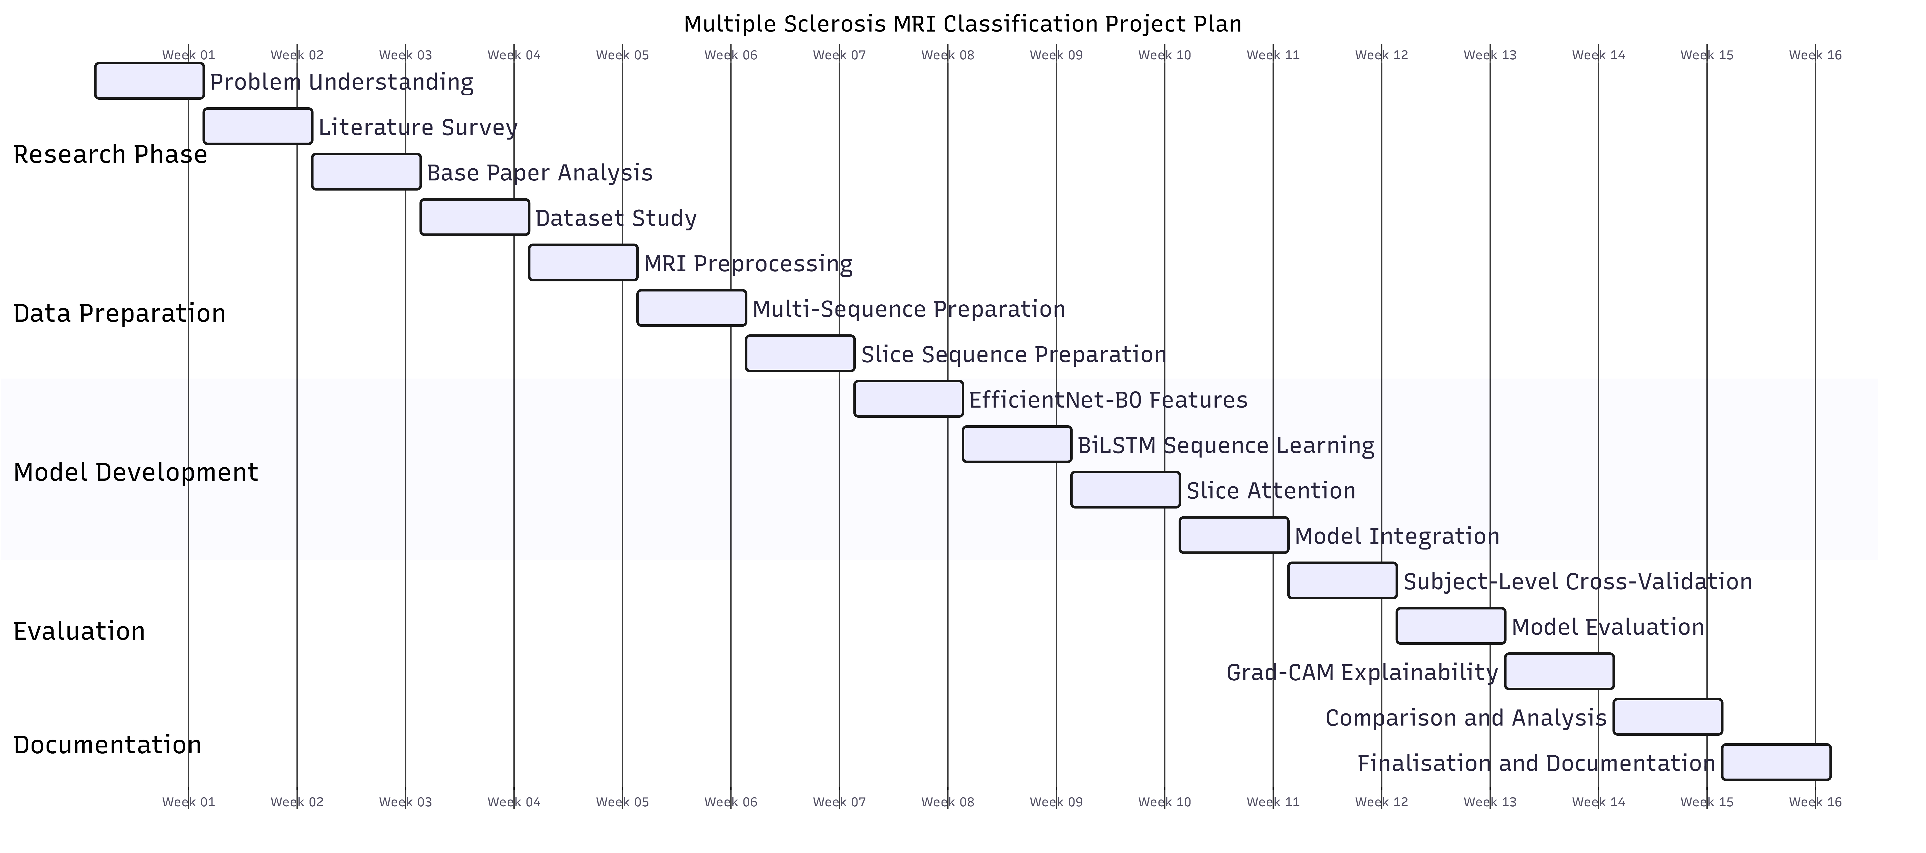
WORK PLAN

Slide 11
THANK YOU

